Slide 1
The importance of data
Storing and processing data is all computers do
All data ultimately binary
Multimedia to user’s perspective
Numbers, text, images, sounds, videos, etc.
Notes:
The primary source for the material in this presentation (including figures and illustrations) is The Architecture of Computer Hardware, Systems Software, & Networking: An Information Technology Approach, 4th edition (plus supplementary materials) by Irv Englander (John Wiley & Sons, 2009).

Slide 2
Data origin
All data originates in computer system’s environment
Brought in via an interface (keyboard, microphone, scanner, etc.) and converted to binary form
Environment is continuous and infinite (analog)
Computer system is discrete and finite (digital)
Often impossible to represent true reality of environment
Typically settle for approximations of reality

Slide 3
Number Performance considerations
Integers
Ops easier for computer
Storage efficient – various sizes
Potential for greater precision and accuracy
Fast
Floating point
Fractional part
Wide range of values
Select smallest size sufficient for task
BCD
Useful for real values when accuracy outweighs performance

Slide 4
Considering data formats
Many different ways to represent data
Once in binary form, data can be stored indefinitely and transmitted repeatedly
Metadata often added to enhance compatibility
Each program free to decide how best to represent its data
Standard, open formats
Proprietary formats

Slide 5
Alphanumeric character data
Text – letters, digits, punctuation, special characters, control characters
Each character gets mapped to a unique pattern of bits
Many such mappings are possible
Choice arbitrary as long as writer and reader agree
Standardized mappings/encodings (character sets) preferable
ASCII – 7-bit (128 chars) – ANSI
Latin-1 Extended ASCII – 8-bit (256 chars) – ISO
Unicode
Sources of textual input
Keyboard, OCR, bar code reader, magnetic stripe reader, RFID reader, natural language software

Slide 6
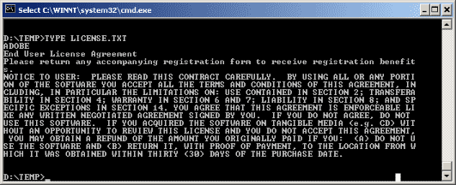
ASCII Encoding

Slide 7
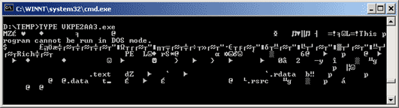
Binary Encoding

Slide 8
ASCII
MSD LSD | 0 | 1 | 2 | 3 | 4 | 5 | 6 | 7
0 | NUL | DLE | SP | 0 | @ | P | ‘ | p
1 | SOH | DC1 | ! | 1 | A | Q | a | W
2 | STX | DC2 | “ | 2 | B | R | b | r
3 | ETX | DC3 | # | 3 | C | S | c | s
4 | EOT | DC4 | $ | 4 | D | T | d | t
5 | ENQ | NAK | % | 5 | E | U | e | u
6 | ACJ | SYN | & | 6 | F | V | f | v
7 | BEL | ETB | ‘ | 7 | G | W | g | w
8 | BS | CAN | ( | 8 | H | X | h | x
9 | HT | EM | ) | 9 | I | Y | i | y
A | LF | SUB | * | : | J | Z | j | z
B | VT | ESC | + | ; | K | [ | k | {
C | FF | FS | , | < | L | \ | l | |
D | CR | GS | - | = | M | ] | m | }
E | SO | RS | . | > | N | ^ | n | ~
F | SI | US | / | ? | O | _ | o | DEL
74₁₆
111 0100
Collating sequence – uppercase vs. lowercase – digits
Printing characters vs. control characters

Slide 9
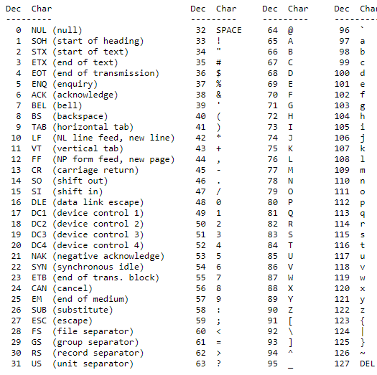
ASCII Table
What is the string "Hello\n" in Extended ASCII expressed as binary space separated nibbles? Ignore quotes
https://www.cs.cmu.edu/~pattis/15-1XX/common/handouts/ascii.html

Slide 10
DOS vs. Unix Line Endings
Text files created on DOS/Windows machines have different line endings than files created on Unix/Linux.
DOS uses carriage return and line feed ("\r\n") as a line ending, which Unix uses just line feed ("\n").
You need to be careful about transferring files between Windows machines and Unix machines to make sure the line endings are translated properly.

Slide 11
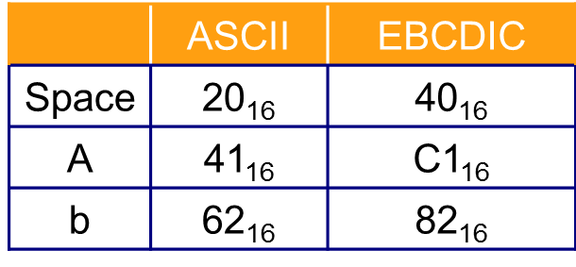
Other character sets
Latin-1 Extended ASCII
ASCII/ISO 8859 (Latin-1) Table (stanford.edu)
Unicode
http://unicode.org/charts/
EBCDIC
http://en.wikipedia.org/wiki/Extended_Binary_Coded_Decimal_Interchange_Code#Codepage_layout

Slide 12
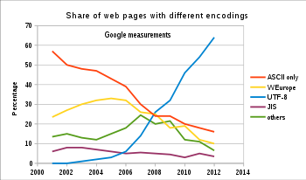
Web Pages with Different Encodings

Slide 13
Unicode: Examples
UTF-8 Multibyte encoding with nice properties ASCII-compatible in a very strong sense, variable length UTF-16 Variable-length encoding, most characters 16 bits Internal encoding for many applications and systems UTF-32 Very simple and straightforward Used on some Unix systems for internal processing
In character encoding terminology, a code point or code position is any of the numerical values that make up the code space

Slide 14
UTF-8 Structure
Number of bytes | Bits for code point | First code point | Last code point | Byte 1 | Byte 2 | Byte 3 | Byte 4
1 | 7 | U+0000 | U+007F | 0xxxxxxx
2 | 11 | U+0080 | U+07FF | 110xxxxx | 10xxxxxx
3 | 16 | U+0800 | U+FFFF | 1110xxxx | 10xxxxxx | 10xxxxxx
4 | 21 | U+10000 | U+10FFFF | 11110xxx | 10xxxxxx | 10xxxxxx | 10xxxxxx

Slide 15
UTF- 8
Easy to detect start of character in byte stream, synchronize in case of errors
Easy to distinguish from other encodings based on byte pattern
No overlapping matches
Strictly protects US-ASCII, important for many protocols and operating systems
Reasonably compact for ASCII-heavy text

Slide 16
Example
'a'
UTF-8
0110 0001
UTF-16
0000 0000 0110 0001
UTF-32
0000 0000 0000 0000 0000 0000 0110 0001

Slide 17
Unicode Example
Consider the encoding of the Euro sign, €. The Unicode code point for "€" is U+20AC
Will take three bytes to encode, since it is between U+0800 and U+FFFF.
UTF-8
1110 0010 1000 0010 1010 1100 2 0 A C
UTF-16
0010 0000 1010 1100

Slide 18
Files
Files consist of blocks of bytes holding bit patterns.
Usually the patterns are recorded on magnetic media such as hard disks or tape. Although the actual physical arrangement varies, you can think of a file as a contiguous block of bytes.
A byte on a magnetic disk can hold 256 possible patterns, the same as a byte in main storage. Reading a byte from disk into a byte of main storage copies the pattern from one byte to another. (For efficiency, disk reads and writes are always done in blocks of 128 bytes or more at a time)
A computer application (a program) provides the context for the bit patterns of the input and output files it uses. If you could somehow inspect the surface of a disk and see the bit patterns stored in a particular file, you would not know what they represented without additional knowledge.

Slide 19
Text Files
So a file contains only bit patterns, as does main memory. What is represented by the bit patterns of a file depends on how they are used.
Textfile is a file containing a sequence of bytes. Each byte holds a bit pattern which represents a printable character or one of several control characters (using the ASCII encoding scheme).
Not all control characters are allowed.
The file can be used with a text editor and can be sent to a hardware device that expects ASCII character code

Slide 20

Considerations when choosing a dataset: formats
Plain Text
ALICE’S ADVENTURES IN WONDERLAND
Lewis Carroll
THE MILLENNIUM FULCRUM EDITION 3.0
CHAPTER I. Down the Rabbit-Hole
Alice was beginning to get very tired of sitting by her sister on the bank, and of having nothing to do: once or twice she had peeped into the book her sister was reading, but it had no pictures or conversations in it, ‘and what is the use of a book,’ thought Alice ‘without pictures or conversations?’
Ends in .txt (generally)
No formatting, font type, font size, color, etc.
Text position is provided by whitespace characters (space, tab, return)

Slide 21
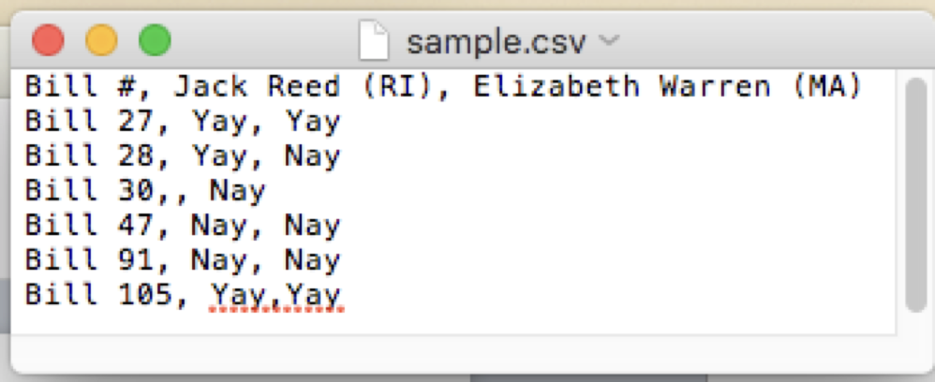
Considerations when choosing a dataset: formats
Plain Text
CSV (.csv)
Tab-separated (.tsv)
Delimiter: The character that separates each value

Slide 22
Considerations when choosing a dataset: formats
XML
XML (.xml)
These colors ——> aren’t actually stored in the file, the editor just adds them on your screen to help make it look prettier
<roll_call_vote>
<congress>115</congress>
<session>1</session>
…
<members>
<member>
<member_full>Alexander (R-TN)</member_full>
<last_name>Alexander</last_name>
<first_name>Lamar</first_name>
<party>R</party>
<state>TN</state>
<vote_cast>Yea</vote_cast>
…
</member>
</members>
</roll_call_vote>

Slide 23
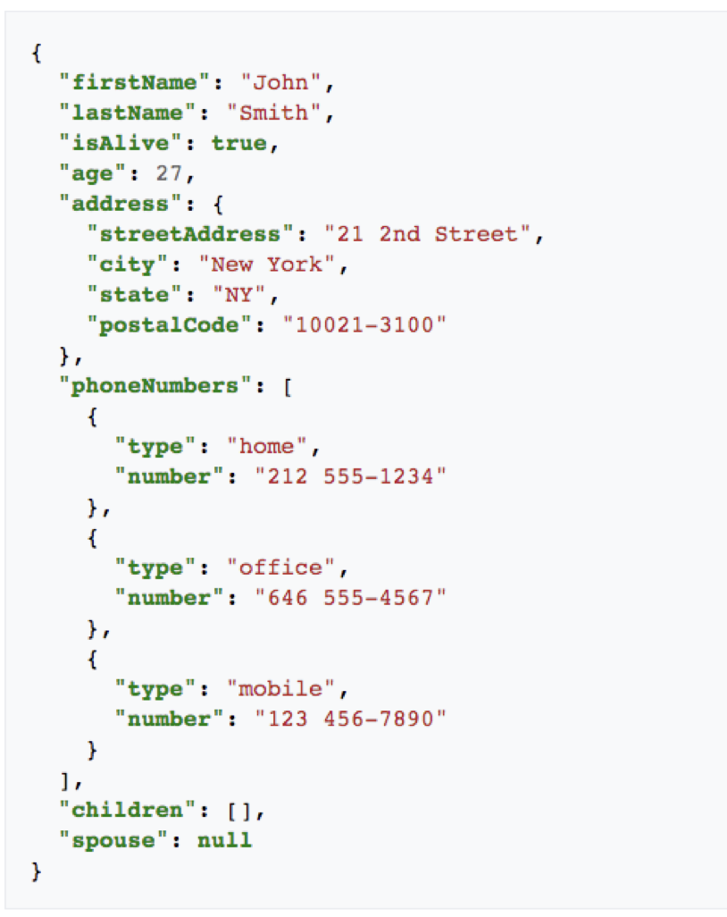
Considerations when choosing a dataset: formats
JSON
JSON (.json)
JavaScript Object Notation
Like XML, data is annotated
A nesting of key-value pairs
When whitespace is removed, can be more space efficient than XML

Slide 24
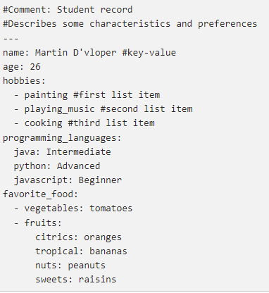
Considerations when choosing a dataset: formats
YAML
.yaml
YAML Ain't Markup Language
Commonly used for configuration files and in applications where data is being stored or transmitted

Slide 25
Considerations when choosing a dataset: formats
They can all express the same content
Plain Text doesn’t have structure, but is very easy to work with
XML is the most verbose, harder to parse
JSON doesn’t have </stuff_here> end tags
JSON is more succinct than XML (easier to parse)
YAML is meant to be "human-friendly data serialization language for all programming languages"

Slide 26
Executable Files
A file containing a sequence of bytes. Each byte holds a bit pattern that represents part of a machine instruction for a particular processor.
The operating system can load (copy) an executable file into main memory and can then execute the program.

Slide 27
Binary Files
A byte in an executable file can contain any possible 8-bit pattern. A file like this often is called a Binary File. This is misleading vocabulary. All files represent their information as binary patterns.
Binary File (colloquial): a file in which a byte might contain any of the possible 256 patterns (in contrast to a text file in which a byte may only contain one of the 128 ASCII patterns, or fewer).
Word File: A file containing a sequence of bytes holding bit patterns created by the MS Word program, which are understood only by that program (and a few others).
There is nothing special about the various "types" of files. Each is a sequence of bytes. Each byte holds a bit pattern. A byte can hold one of 256 possible patterns (although some file types allow only 128 or fewer of these patterns). When longer bit patterns are needed they are held in several contiguous bytes.

Slide 28
Image data
Many image formats exist
Divisible into two broad categories
Bitmap/raster image
Collection of pixels
Paint programs and photo editors
JPEG, GIF, PNG, BMP, TIFF, etc.
Vector/object image
Collection of geometrically defined objects
Draw programs
SVG, Flash, PostScript, etc.

Slide 29
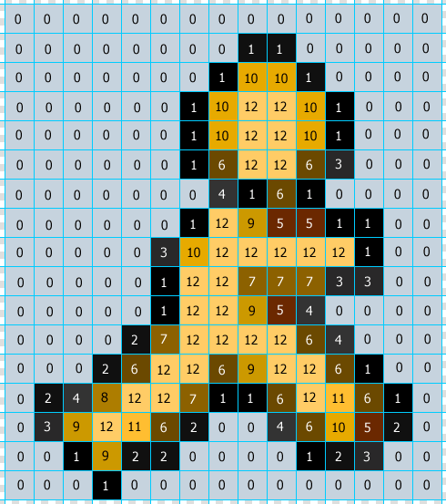
Bitmap images
Superimpose grid over image
Each square is a picture element (pixel)
Record characteristics of each pixel in numeric form
Color, color intensity, transparency, etc.
Include metadata to clarify interpretation
Store pixel data row by row from top to bottom
Each pixel’s data could require 1 bit to many bytes
Storage adds up quickly
Approximation of original
Each pixel must be only one color
More pixels, more detail, more storage
Resolution
Useful for highly detailed images and those that require whole-image processing

Slide 30
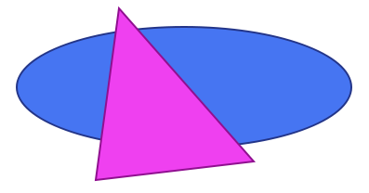
Object images
Geometric primitives
Shapes, lines, curves, etc.
Mathematically defined
Varied through parameters
Easily transformed
Representable as text
Require much less storage
Pixels determined at display time
Easier to manipulate component parts
Each maintains its own identity
Most output devices are raster devices
Must be rasterized prior to display
Trade storage savings for more processing
<?xml version="1.0" standalone="no"?>
<!DOCTYPE svg PUBLIC "-//W3C//DTD SVG 1.1//EN"
"http://www.w3.org/Graphics/SVG/1.1/DTD/svg11.dtd">
<svg width="100%" height="100%" version="1.1"
xmlns="http://www.w3.org/2000/svg">
<ellipse cx="250" cy="160" rx="180" ry="65"
style="fill:#4675F2; stroke:#233589; stroke-width:2" />
<polygon points="180,75 325,240 155,260"
style="fill:#EF40F0; stroke:#901090; stroke-width:2" />
</svg>

Slide 31
Video images
Series of still images (frames) shown in sequence
Bitmap images most common
Multiplies storage requirements by frame rate
Results in tremendous storage requirements
Various optimization techniques
Reduce frame dimensions
Limit colors
Reduce frame rate
Spatial compression
Temporal compression
Streaming

Slide 32
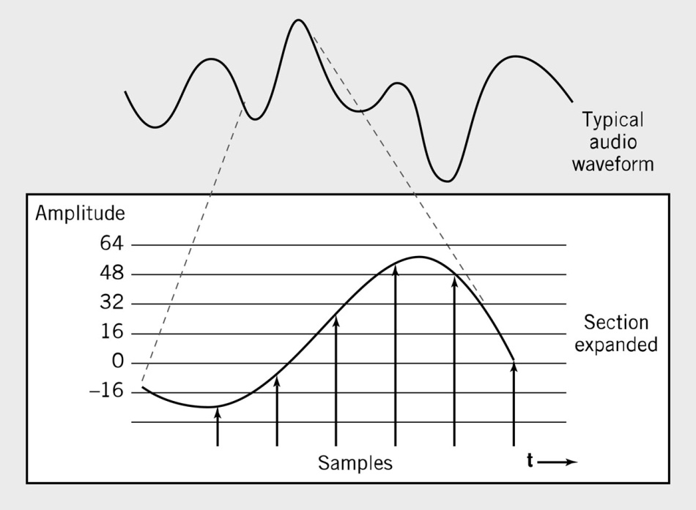
Audio data
Sound consists of smooth, continuous waves
Infinite variability between any two points
Must be represented numerically in computer
Numerical representations are discrete and finite
Sampling determines amplitude of original wave at regular intervals
Records those amplitudes as numeric values
Often supplemented with metadata
Sequence can be used to reconstruct approximation of original wave
Higher sampling rates produce closer approximations, but more numbers means more storage
Common sampling rate is 44,100 Hz (samples per second)
MPEG, MP4

Slide 33
Data compression
Reorganizing data so it requires less storage and bandwidth
Compression ratio = compressed size/original size
0 < n < 1 – smaller values indicate better compression
Compression types
Lossless vs. lossy
Tradeoffs
More processing typically required
Point of diminishing returns

Slide 34
How could we lossless compress this string?
111A11B11CD00CDCDA 18 characters
Counts of a frequent character(s)
111A11B11CD00CDCDA
Map patterns to symbols CD -> X, 11 -> Z
Z1AZBZX00XXA 12 characters
.666 compression ratio

Slide 35
Huffman encoding
Text compression protocol using variable length bit patterns
Short patterns for common characters
Requires unambiguous patterns
Freq
Code
G
2.77
10101
P
2.58
10110
U
2.43
10111
Freq
Code
F
2.28
11001
E
12.32
100
Y
1.46
010101
T
8.37
111
A
8.23
0000
B
1.26
110000
I
8.08
0001
W
1.07
0101000
S
7.64
0011
V
0.97
0101001
O
7.59
0100
K
0.43
1100011
N
6.81
0110
R
6.67
0111
X
0.29
11000101
C
4.04
1101
J
0.14
110001001
H
3.94
00100
L
3.79
00101
Q
0.14
1100010000
D
3.40
01011
Z
0.09
1100010001
M
3.06
10100

Slide 36
Example "CAT"
Bit sequence for UTF-8
4 3 4 1 5 4
0100 0011 0100 0001 0101 0100 3 bytes 24bits
Huffman
1101 0000 111 11 bits
11/24
Lossless compression

